Slide 1

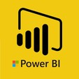
Hii,
Iam Siddhika
Welcome to Power BI Series
Part -82

Slide 2


Today Content
I’m very excited to dive into this with you all!
Are you ready to enhance your data visualization skills?
VISUALIZING DATA
PARAMETERS (CONTINUATION) 1.FIELDS PARAMETERS(EXMPLE)

Slide 3

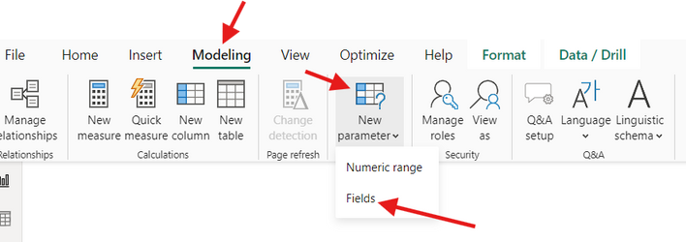

1.FIELDS PARAMETERS(EXMAMPLE):
check next slide..
Objective: Allow users to dynamically switch between different Sales Categories (Category, Subcategory, Country, Year) using a slicer.
Step 1:
Open your Power BI report.
Navigate to the Modeling tab in the top menu. Click on New Parameter and select Fields from the dropdown. This option allows you to create a parameter that will let users switch between different fields.

Slide 4

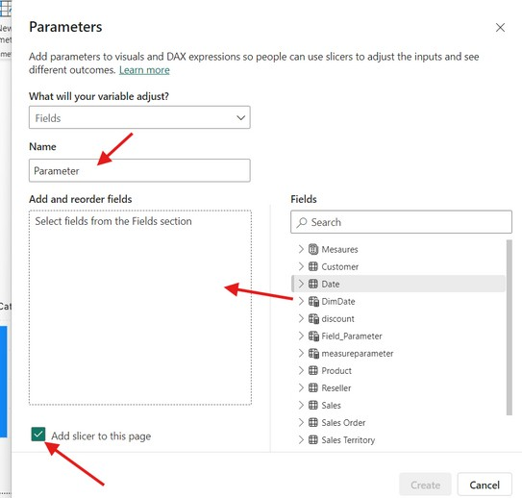
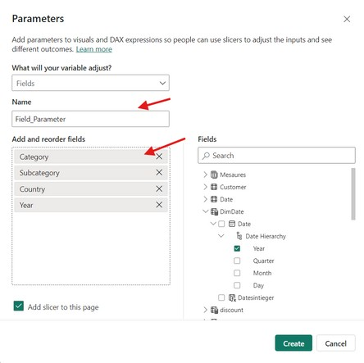
Step 2:Define the Field Parameter
Name: Enter a name for your parameter, such as "Field Parameter"
Drag or Select Fields: Choose the fields you want to include in this parameter. For this example, select Category, Subcategory, Country, and Year.
Add Slicer to This Page: Make sure this option is checked so that a slicer is automatically added to your report page.
do along with
me

Slide 5

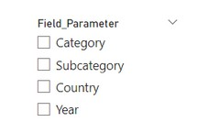


Step 3:Create the Parameter
After setting up your fields and naming the parameter, click Create. Power BI will generate the parameter and add a slicer to your report page.
Easy..
Step 4:Add a Visual
Drag a visual, such as a Stacked Column Chart, onto your report canvas

Slide 6
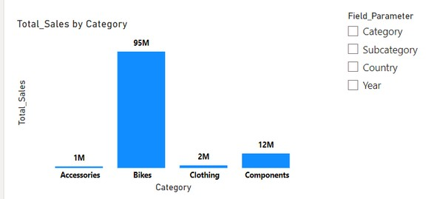
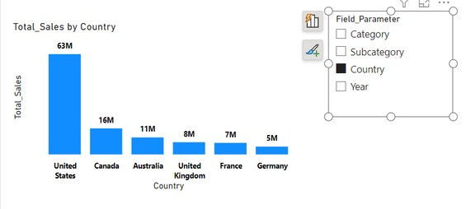
Step 5:Set Up the Visual
Y-Axis: Drag the Total Sales measure to the Y-axis of your visual.
X-Axis: Drag the newly created Field Parameter to the X-axis.
Step 6:Use the Field Parameter Slicer
Now, you can interact with the report by selecting different options in the Field Parameter slicer.
The visual will dynamically update to show Total Sales by
Try it..
the selected category (e.g., Category, Subcategory, Country, or Year)

Slide 7


Thank you for joining me today to learn about Part -82 of Power BI!
Remember, Effective data visualization is crucial for turning data into meaningful insights and compelling narratives with Power BI.
Stay tuned for more insights and tips on Power BI in our next Series.
Follow

